Slide 1




Sprint 4
Triathlon Performance
Joseph Furmanowski
Justyce Graham
CS-104-01, Monmouth University
Endurance
Accuracy
Agility

Slide 2

Challenges We Faced
Developing and testing our software off-campus
  Our team decided that it would be best to stay safe and work off-campus
  Access to the Monmouth University campus is limited due to COVID-19 safety restrictions
  We had to recreate the on-campus course layouts in our limited space at home by proportionately decreasing all the course dimensions. We took great care in ensuring that our software still performs per the requirements
Working with each other’s schedules
  As first-year college students, we are trying to balance our work and student lives, especially in the midst of the pandemic, our transition to college, and online learning
  It was sometimes hard for us to find a mutually agreed upon time to plan for and work on each sprint
Technical difficulties
  We had some issues connecting to the robot with Bluetooth that required restarts of both devices
  Editing the code on our PCs and trying to sync it to the mobile app sometimes would not work and thus gave us difficulties

Slide 3

What We Learned About Software Engineering
Project planning
  Planning ahead and using Gantt charts gave us a good roadmap for each project and made clear which goals needed to be met in a certain timeframe
Adaptation
  We learned to adapt by working around and developing solutions for unfortunate circumstances, such as having to complete the sprints off-campus
  We adapted by making our own course layouts and staying in contact with Professor Eckert to ensure the project is still being done properly at home
Patience/trial and error
  We learned to be patient with team members and understand the collaboration process; it takes lots of patience and effort to complete each task successfully
  We learned to test code thoroughly and fix inaccuracies that appear
Communication/teamwork
  We learned to communicate effectively and clearly to team members in order to complete our tasks on-time and fulfill our responsibilities
  Looking to team members for advice and different perspectives on how to tackle an issue helped solve problems
Software engineering is not easy
  Software engineering involves lots of critical thinking, tweaking, and collaboration

Slide 4

Looking Back
In retrospect, we should have done a couple of things differently.
Sharing the robot more often
  Sharing the robot more often between team members would have given everyone the opportunity to work with the robot hands-on and gain crucial experience with the Sphero software
  In order to have a better understanding of the code that controls the Sphero robot, it is very important to have access to the physical robot
Better time management
  We could have completed each sprint more efficiently if we spread out the workload more rather than condensing it all into a few days
Try out more of the features in the Sphero software
  The Sphero Edu software provides many powerful tools and commands to program a robot. We definitely could have taken more advantage of the tools and commands provided to us by Sphero

Slide 5


Team Member Roles
Joseph Furmanowski
PROJECT MANAGER
PROGRAMMER
Justyce
Graham
PROGRAMMER
Responsibilities Overview
Oversee projects and maintain quality control
Develop plans
Build requirements tables
Develop flow charts
Write code
Execute, test, and revise code and algorithms
Log sensor data
Write System Design Document (SDD)
Collaborate via GitHub
Responsibilities Overview
Develop plans
Finalize the Gantt charts and verify that they suit the project plan
Write Sections 1 and 2 of the System Design Document (SDD)
Write code
Collaborate via GitHub

Slide 6
Sprint 3
Agility Performance
Block Code & Video

Slide 7
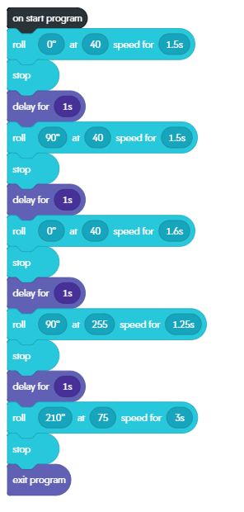
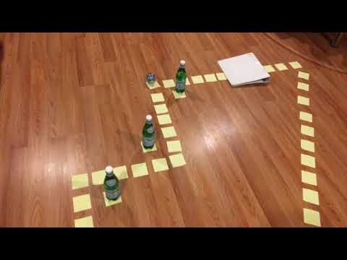
Sprint 3 — Agility Performance
Block Code
Video
Video can also be found on our GitHub repository at https://github.com/joefurmanowski/Presentation/blob/main/Agility.mov

